Slide 1
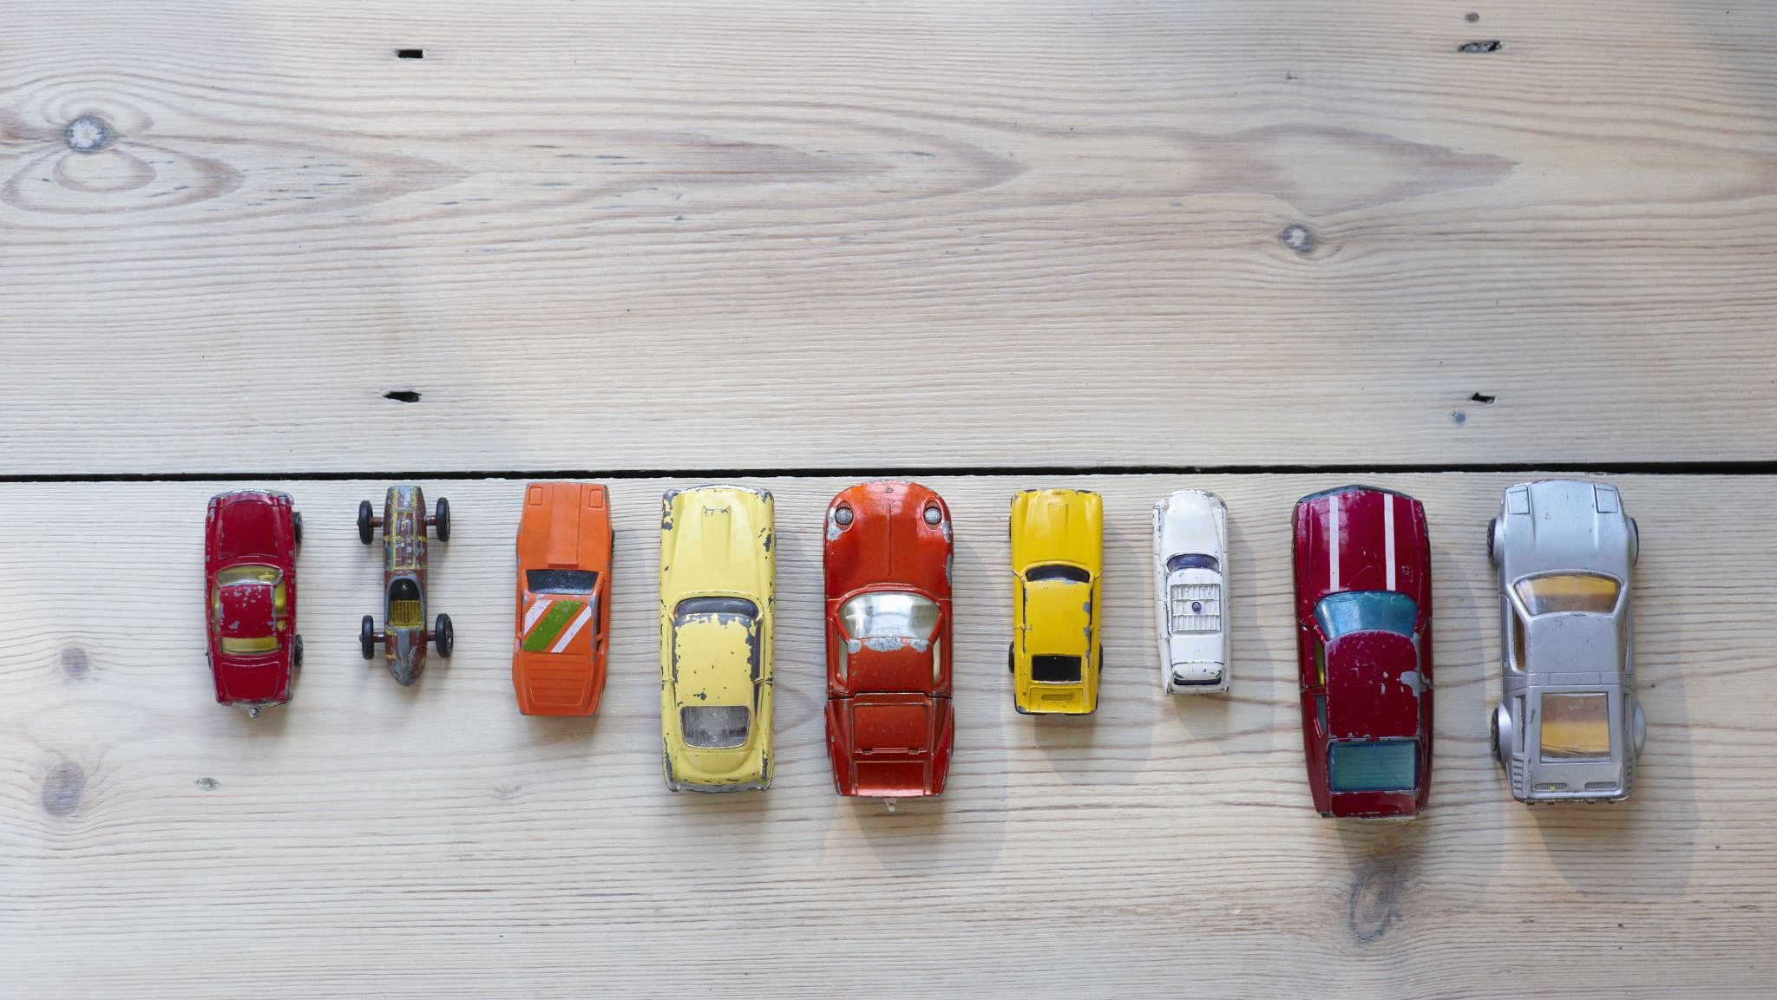
US USED CARS DATASET
CIS5560, Spring 2023
Instructor: Jongwook Woo
Presented by: Group 2
Anusha Valasapalli
Naga Sai Lohitha Karmuru
Rishabh Shah
Wethanie Law

Slide 2

AGENDA
Objective
About the dataset
Dataset Specifications
Technical Specifications
Machine learning algorithms used
What is classification and regression
Explanation of algorithms used in the project
Model results comparison table for regression and classification
Conclusion
GitHub Link and references

Slide 3
OBJECTIVE
The major goal of the project is to predict the price of used cars in the United States using regression models and machine learning algorithms based on characteristics such as manufacturing date, mileage, and owner count.

Slide 4
ABOUT THE DATASET
Contains three million real world used cars details.
The dataset includes information about the cars' make and model, year of production, mileage, condition, location, and price.
The dataset can also be used to forecast demand for specific car models in different regions and estimate the expenses associated with typical automotive problems.

Slide 5

DATASET SPECIFICATIONS
DATASET NAME: USA Used Car Dataset
TOTAL DATASET SIZE: 9.98 GB
DATASET FORMAT: CSV
DATASET URL: https://www.kaggle.com/datasets/ananaymital/us-used-cars-dataset

Slide 6


TECHNICAL SPECIFICATION
Databricks Community Version: 9.1 LTS (includes Apache Spark 3.1.2, Scala 2.12)
File System: DBFS (Data Bricks File System)
Nodes: 1
Python Version: 3.10.4
Hadoop Version: 3.2.1
Number of CPU core: 8
PySpark version: 3.0
Number of Nodes: 3
Total Storage: 390.71 GB

Slide 7
MACHINE LEARNING ALGORITHMS USED
Regression:
Linear Regression
Random Forest
Gradient Boosted Trees(GBT)
Factorization Machine Regressor
Classification:
Decision Tree Classifier
We trained all the above algorithms with train validation and cross validation split
Notes:
Our project employed a variety of algorithms to perform predictive analysis. Specifically, we utilized four algorithms, consisting of three regression models, namely Linear Regression, Random Forest, and Gradient Boosted Trees. In addition, we incorporated a Decision Tree Classifier for classification purposes. Furthermore, within the Gradient Boosted Trees algorithm, we developed two distinct models. Overall, the use of multiple algorithms that allowed perform the predictive analysis and provide valuable insights into the dataset.

Slide 8

REGRESSION AND CLASSIFICATION SIMILARITIES AND DIFFERENCES EXPLAINED
Similarities:
Supervised learning, require labeled data to train and make predictions.
Create a model that can learn patterns from the data, then use those patterns to make predictions on new, unseen data.
Use mathematical algorithms to train and optimize the model.
Difference:
Use different algorithms
Regression: linear regression, Gradient Boosted Tree(GBT), Random Forest, decision trees regression & ect.
Classification: Logistic regression, decision trees classifier and etc.
More difference (cont’d) ​

Slide 9
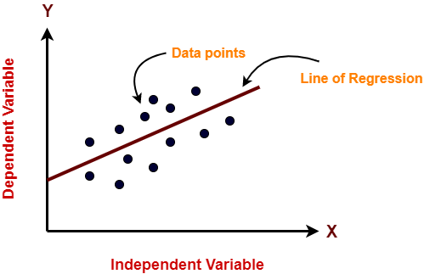
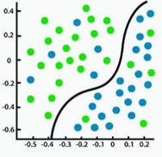
REGRESSION AND CLASSIFICATION SIMILARITIES AND DIFFERENCES EXPLAINED (Cont'd)
​ | Regression​ | Classification​
Description​ | Predict a continuous quantity​ | Predict some class label​
Type of Response​ | Continuous (price, stock, salary etc.​) | Categorial​ (Yes or not, spam or not)
Assess Value​ | RMSE / R2​ | AUC/ROC​
Scatter Plot Exp​ | ​ | ​

Slide 10
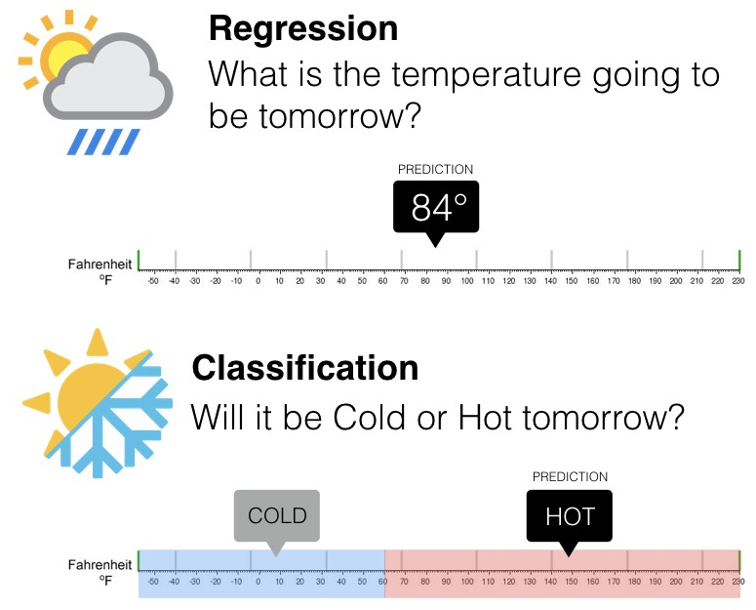
REGRESSION AND CLASSIFICATION SIMILARITIES AND DIFFERENCES EXPLAINED (Cont'd)

Slide 11








PREDICTION SYSTEM FLOWCHART​
Historical Data
New Data
Train Data
Feature Engineering
ML Algorithm
Model
Result
Test Data
Model Validation

Slide 12

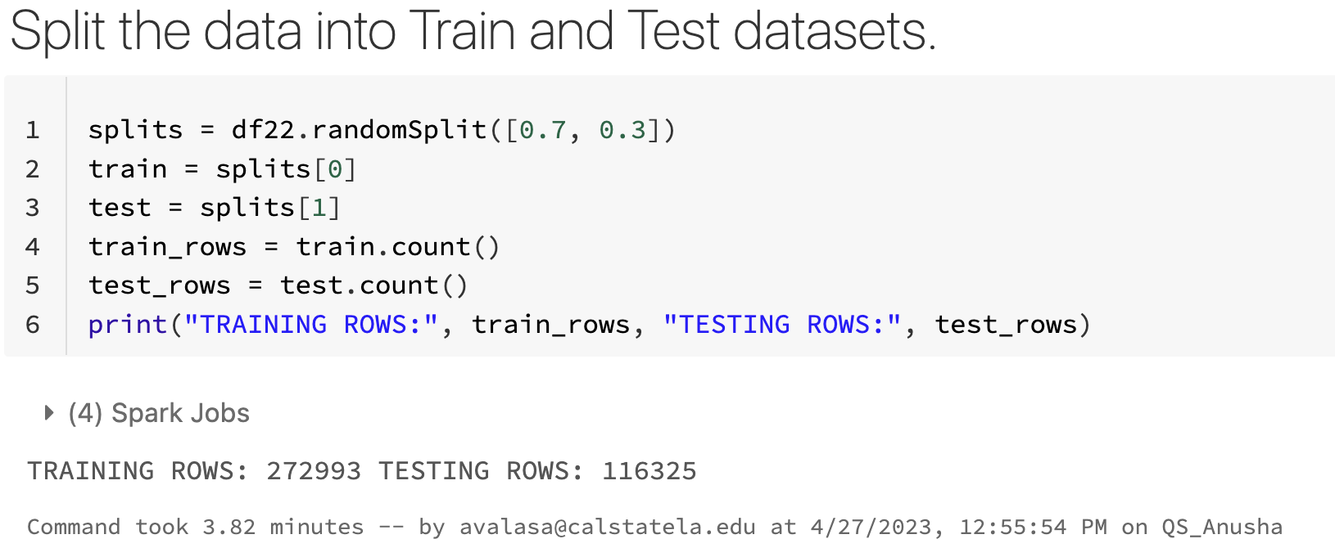
SPLITTING THE DATASET​
Splitting the dataset into a 70-30 ratio for training and testing respectively

Slide 13
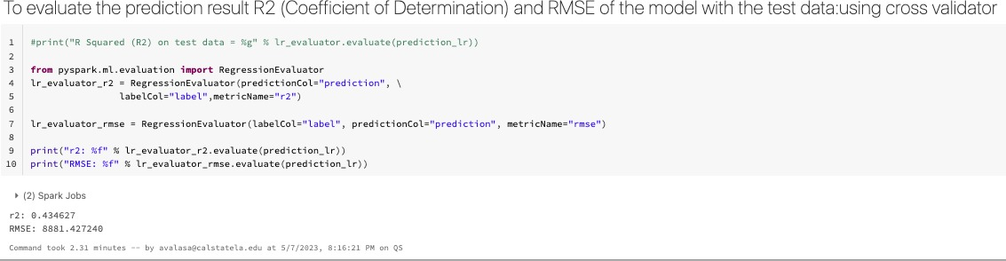
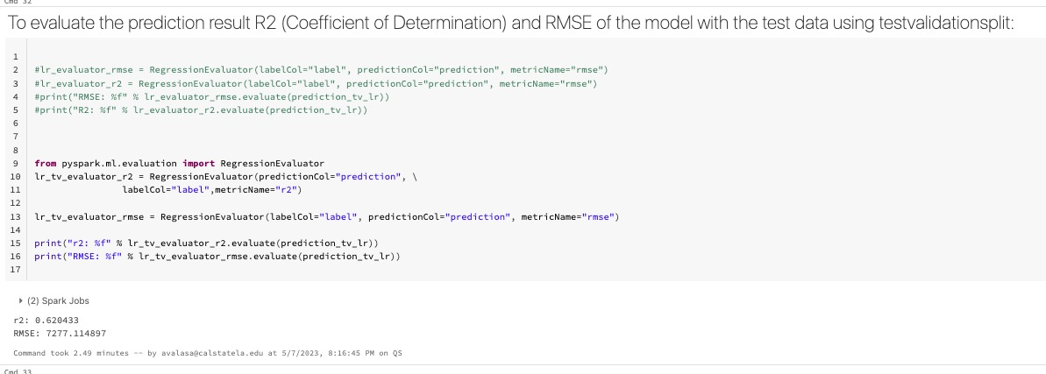

LINEAR REGRESSION​
Training the model for the Cross validator is 12.10 mins
R2: 0.43
RMSE: 8881.42
Training the model for the Train Validator split is 7.96 mins R2: 0.62
RMSE: 7277.11

Slide 14
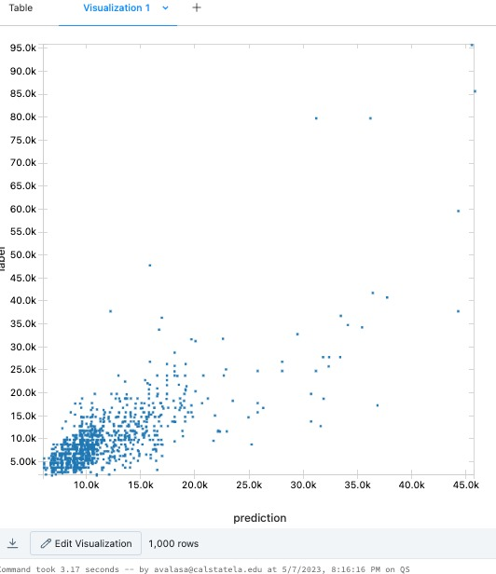
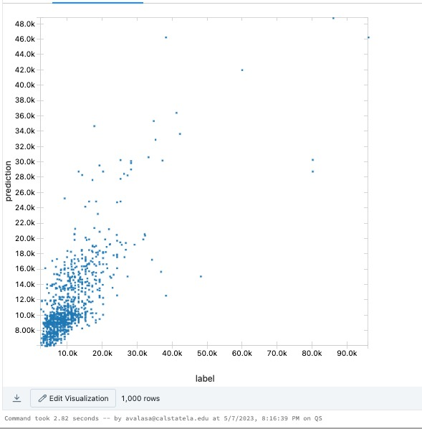
VISUALISATION RESULT​
CV
TVS

Slide 15
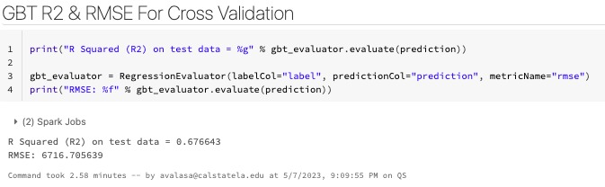
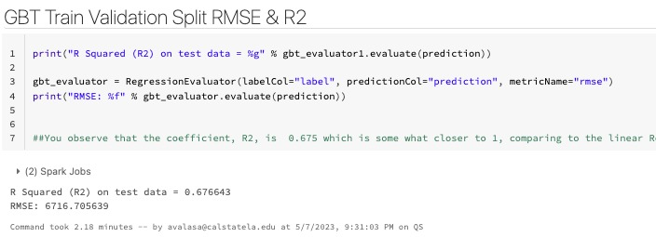
GRADIENT BOOSTED TREE(GBT)​
Training the model for the Cross validator is 33.16 mins
R2: 0.67
RMSE: 6716.70
Training the model for the Train Validator split is 15.08 mins
R2: 0.67
RMSE: 6716.70

Slide 16
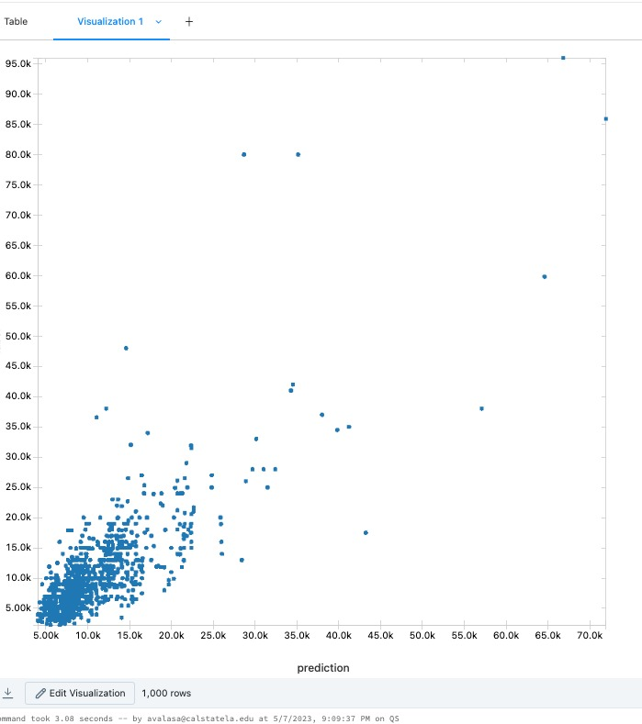
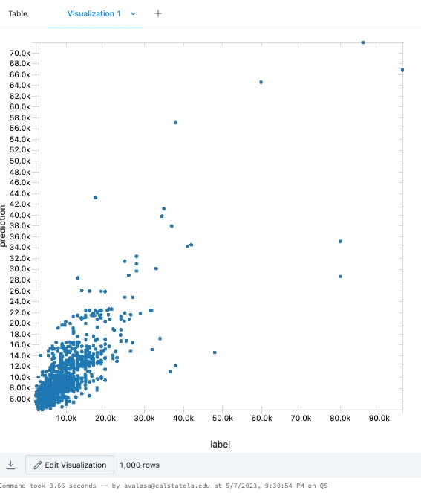
VISUALISATION RESULT​
CV
TVS

Slide 17
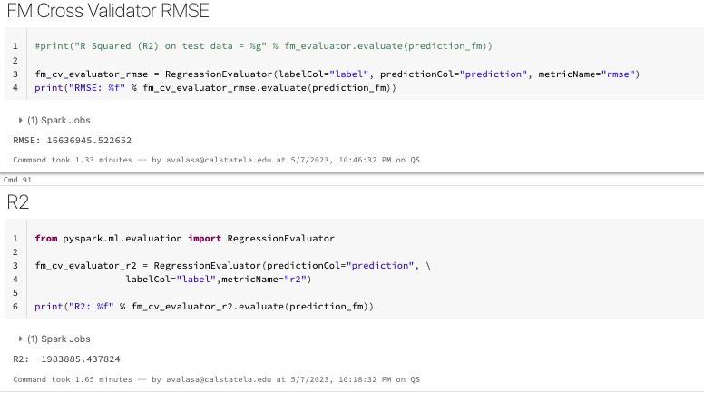
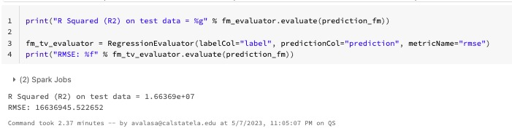
FACTORIZATION MACHINE REGRESSOR
Training the model for the Cross validator is 23.42 mins
R2: -1983885.43
RMSE: 16636945.52
Training the model for the Train Validator split is 9.57 mins
R2: 1.66
RMSE: 16636945.52

Slide 18
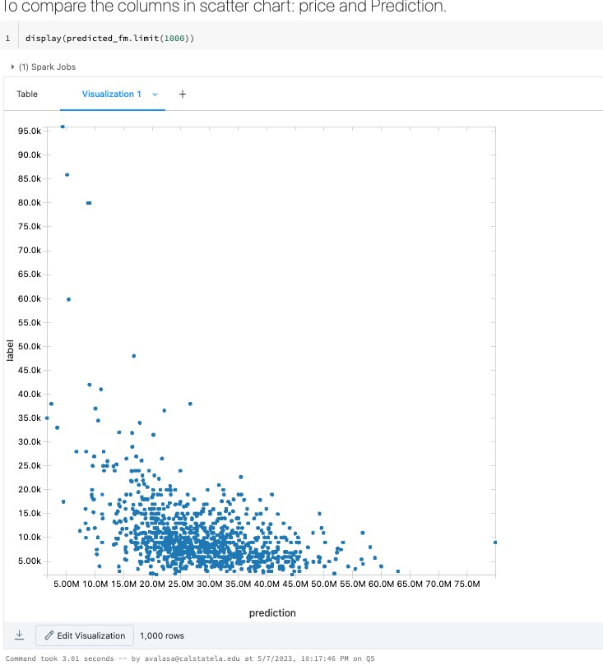
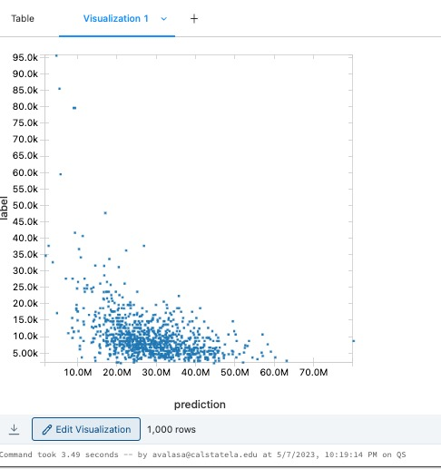
VISUALISATION RESULT​
CV
TVS

Slide 19
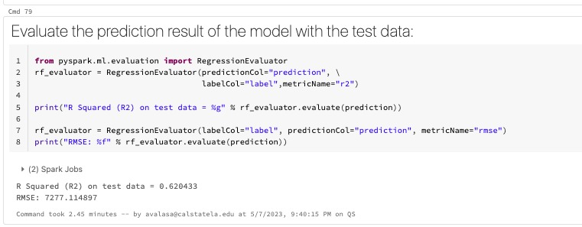
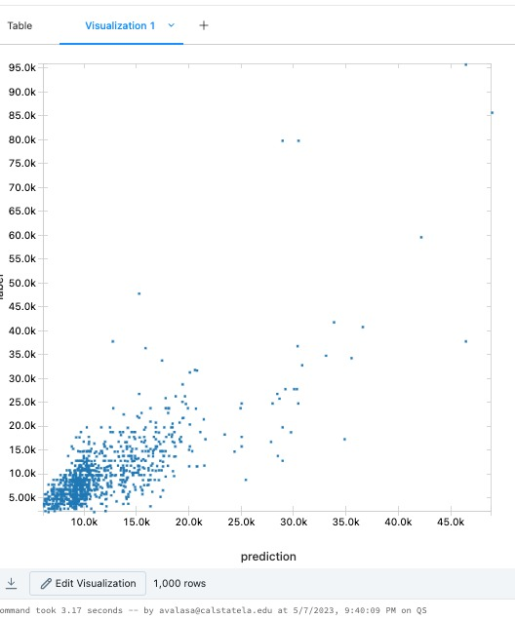
RANDOM FOREST REGRESSOR
Training the model is 4.83 mins
R2: 0.62
RMSE: 7277.11

Slide 20
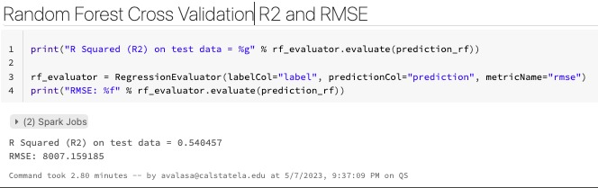
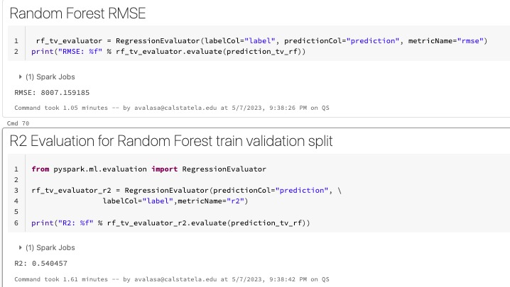
RANDOM FOREST REGRESSOR
Training the model for the Cross validator is 12.83 mins
R2: 0.54
RMSE: 8007.15
Training the model for the Train Validator split is 7.29 mins
R2: 0.54
RMSE: 8007.15

Slide 21
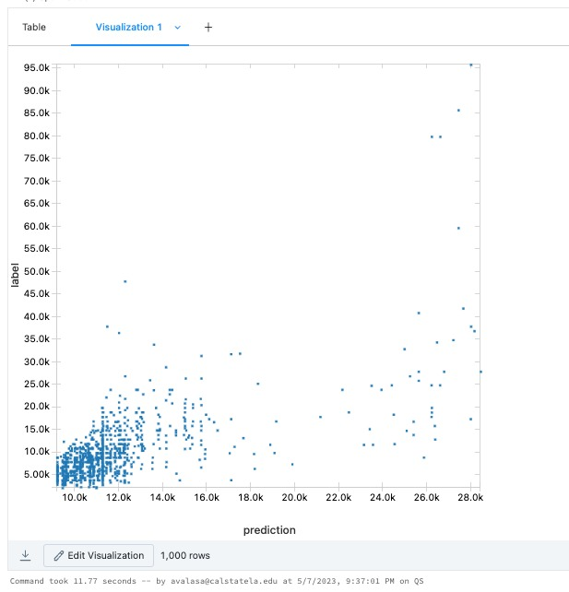
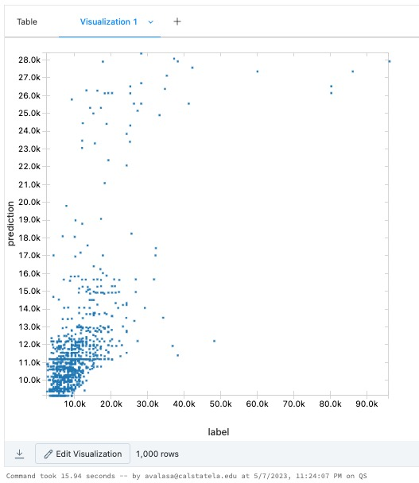
VISUALISATION RESULT​
CV
TVS

Slide 22
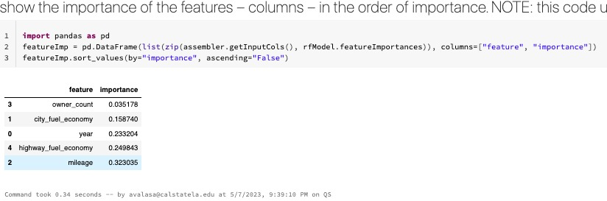
FEATURE IMPORTANCE ​
Mileage has the highest importance score which is 0.323035

Slide 23
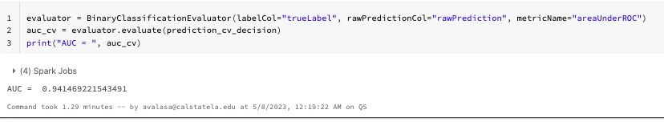
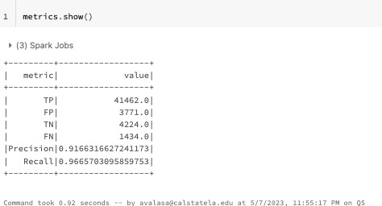
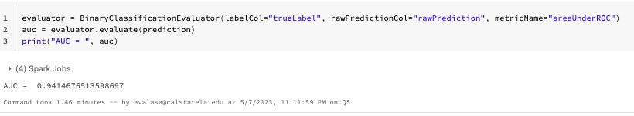
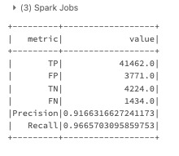
DECISION TREE CLASSIFIER
Training the model for the Cross validator is 19.42 mins
AUC: 0.941
Training the model for the Train Validator split is 12.13 mins
AUC: 0.941

Slide 24
MODEL RESULTS COMPARISON TABLE FOR REGRESSION WITH CROSS VALIDATOR ​
Model | RMSE | R2 | Runtime
Linear Regression | 8881.42 | 0.43 | 12.10 mins
GBT | 6716.70 | 0.67 | 33.16 mins
Factorization Machine Regression | 16636945.52 | -1983885.43 | 23.42 mins
Random Forest Regressor | 8007.15 | 0.54 | 12.83 mins

Slide 25
MODEL RESULTS COMPARISON TABLE FOR REGRESSION WITH TRAIN VALIDATOR ​SPLIT
Model | RMSE | R2 | Runtime
Linear Regression | 7277.11 | 0.62 | 7.96 mins
GBT | 6716.70 | 0.67 | 15.08 mins
Factorization Machine Regression | 16636945.52 | 1.66 | 9.57 mins
Random Forest Regressor | 8007.15 | 0.54 | 7.29 mins

Slide 26
MODEL RESULTS COMPARISON TABLE FOR CLASSIFICATION WITH CROSS VALIDATOR ​
Model | Precision | Recall | AUC | Runtime
Decision Tree Classifier | 0.916 | 0.966 | 0.941 | 19.42 mins
MODEL RESULTS COMPARISON TABLE FOR CLASSIFICATION WITH CROSS VALIDATOR ​
Model | Precision | Recall | AUC | Runtime
Decision Tree Classifier | 0.916 | 0.966 | 0.941 | 12.13 mins

Slide 27
CONCLUSION
The project involved the use of various machine learning algorithms to investigate patterns and trends in data, forecast prices and demand for various types of cars, and establish pricing models and tactics for sellers and buyers.
The project's findings can help many stakeholders in the used automobile market, such as car dealerships, online marketplaces, and individual buyers and sellers, make better judgments when buying, selling, or pricing used cars.

Slide 28
GITHUB LINK
https://github.com/anushavalasapalli-97/CIS-5560 US_USED_CARS_PROJECT-

Slide 29
REFERENCES
https://spark.apache.org/docs/2.2.0/ml-pipeline.htmlhttps://spark.apache.org/docs/latest/ml-tuning.html
https://www.kaggle.com/datasets/ananaymital/us-used-cars-dataset

Slide 30
THANK YOU

